Slide 1
Questions: brand@microsoft.com

Slide 2
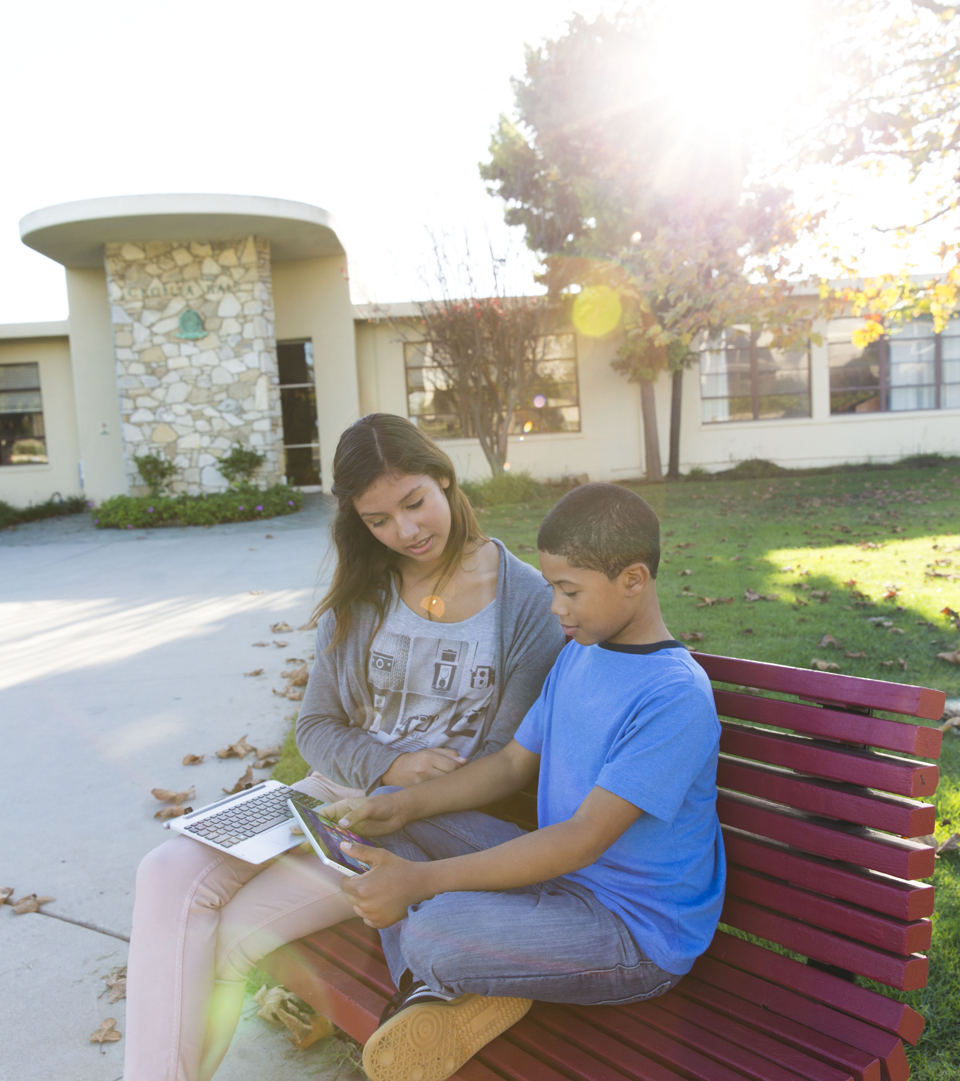
Questions?

